Slide 1
CA Certificates on TBS WiFi
What is a CA certificate
A digital certificate which guarantees the trustworthiness of the webpage or network you are connecting to
Normally they are issued by Certification Authorities (eg. GeoTrust, Verisign etc)
For private networks, in the past, they were issued by these Certification Authorities. They no longer can issue them for local or ‘private’ networks like an intranet
Nowadays private networks must issue their own.

Slide 2
Without the certificates, it is not possible to navigate and browsers usually bring up a message saying the network or webpage are not secure
Navigating or using a network with a certificate allows security systems to scan for malware and malicious connections.

Slide 3
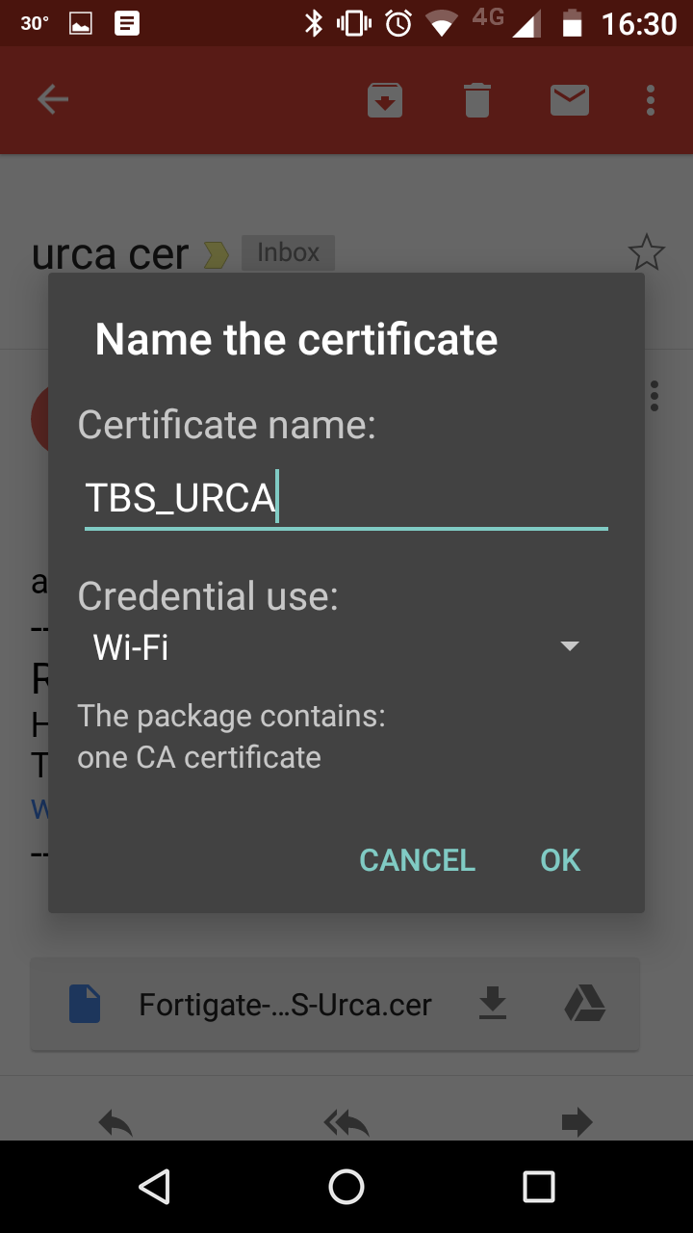
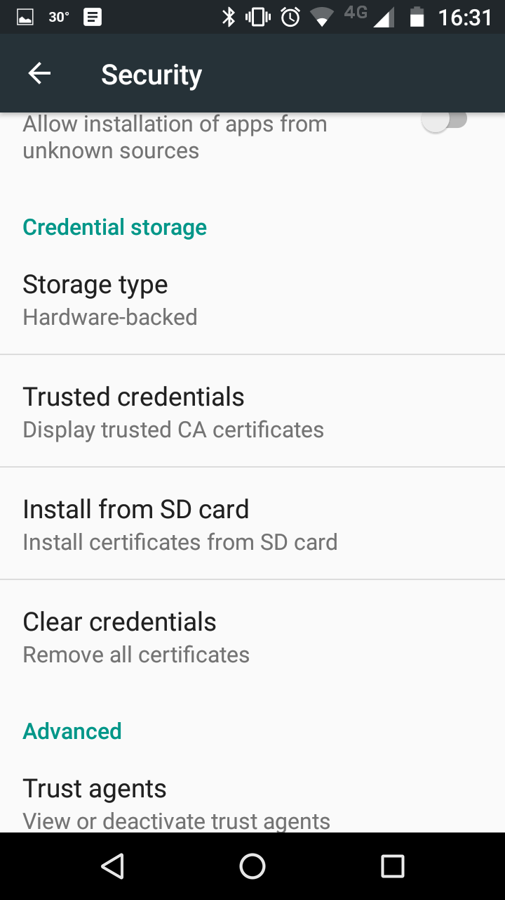

Slide 4
